Slide 1
Investigating a major incident at the Vihtavuori plant and the lessons learned
Notes:
A major incident occurred at Forcit Ltd’s Vihtavuori plant in Laukaa on 9-10 July 2013. The major accident risk led to the evacuation of the whole Vihtavuori Village, which has about 2000 inhabitants.

Slide 2
Overview of presentation
The presentation is divided into three main parts:
A brief summary of what happened at the Vihtavuori plant on 9–10 July 2013
The factors that led to the major accident risk
The investigation group’s main recommendations in order to learn from the Vihtavuori case and improve safety in the future.

Slide 3
Part 1: A brief summary of what happened at the Vihtavuori plant

Slide 4
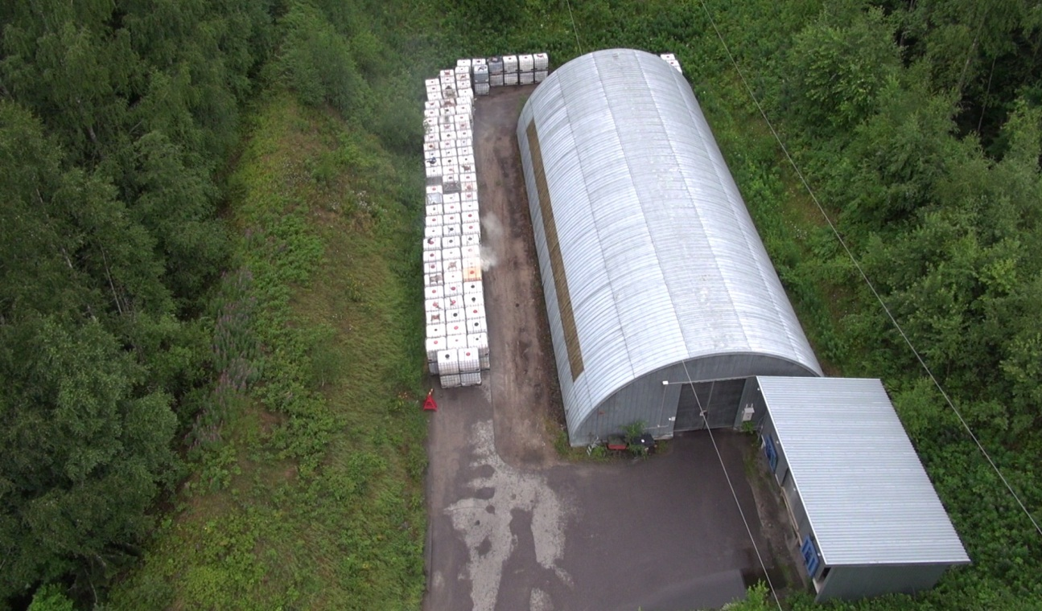
The major accident risk on 9-10 July, 2013
Notes:
The major accident risk occurred at the Vihtavuori plant when a waste container started to give off steam next to an explosives warehouse. At that time, there were 40 tonnes of explosives in the warehouse. At the beginning of the rescue procedure, the exact number of waste containers was unknown.
The exact number of waste containers was later calculated when the warehouse area was being filmed by a helicopter camera.
An explosion had occurred previously in a waste container in the disposal area, and a waste container in a production building had gone on fire just a few months before the event. In both cases there had been an unidentified substance in the containers, and based on these incidents, it was realized that a reaction might accelerate rapidly. There was a danger that the container would burst into flames or explode, so it was regarded as unsafe for the rescue crew to approach the warehouse area.
The major accident risk was caused by a lack of knowledge concerning the contents of the container and the reaction process. The major risk scenario was that the container would either explode or go on fire, and that the effects would spread to the 200 containers and explosives in the warehouse. At the time of the incident, the total amount of explosives was estimated to be about 140 tonnes. The warehouse is licensed to store 80 tonnes of explosives.
There is no licence covering the storage of waste containers in the warehouse yard. Waste containers are not taken into account in either risk scenarios or emergency plans. From the rescue operation point of view, it is essential to know the type and quantity of chemicals and explosives stored inside a particular container.
At the request of the rescue services at the time of the event, the Forcit expert assessed what might have happened in the worst-case scenario (i.e. an explosion involving all the waste containers and the contents of warehouse). The probability that everything would explode was regarded as highly unlikely, but at the time of the incident, it could not be completely ruled out.
As an explosion could not be completely ruled out, the rescue services decided to evacuate all the inhabitants in the area before they attempted to move the container and cool down the interior.

Slide 5
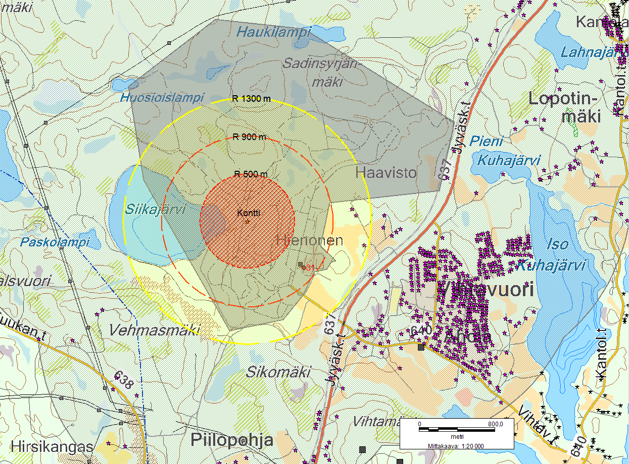
The evacuation: 2000 inhabitants from Vihtavuori Village
Notes:
At the time of the event, Forcit estimated that the potential effects of the accident could have extended to a radius of about 1300 metres from the explosives warehouse. At this distance, hearing injuries would no longer be likely, but other damage could occur such as windows being broken.
To safeguard all inhabitants, the rescue services extended the evacuation decision to cover all 2000 residents in Vihtavuori Village. In practice, 450 people were evacuated; the rest left voluntarily, or they were assumed to be away from home.
Due to the major accident risk and the wide evacuation operation, Tukes decided right away on 10 July to establish an investigation group to investigate the causes of the incident and to make recommendations for improving safety.

Slide 6
Tukes is responsible for investigating serious accidents and incidents

Slide 7
Tukes’s investigation at the Vihtavuori plant
The aim was to discover the chain of events and the risk factors that led to the incident and to make recommendations for safety improvements.
The investigation got underway at the Vihtavuori plant by examining the storage area where the incident took place and interviewing Forcit workers.
Later, the investigation was extended to the Pyhäsalmi Mine, from where the steaming waste container originated.
The investigation team studied Tukes’s archive material, and additional documents and data were requested from the companies in question.
The companies in question demonstrated clear and open co-operation during the investigation. All requested material and clarifications were distributed without any delay.
An accident or a serious incident always has a number of different causes. An accident investigation is always a complex and difficult process, and there is never one definitive cause.
Tukes’s investigation report was published on 1 October, 2012 and is available in Finnish on Tukes’s webpages (www.tukes.fi). These slides and an English summary of the investigation are also available on the website.

Slide 8
Part 2: Factors that led to the major accident risk at the Vihtavuori plant

Slide 9
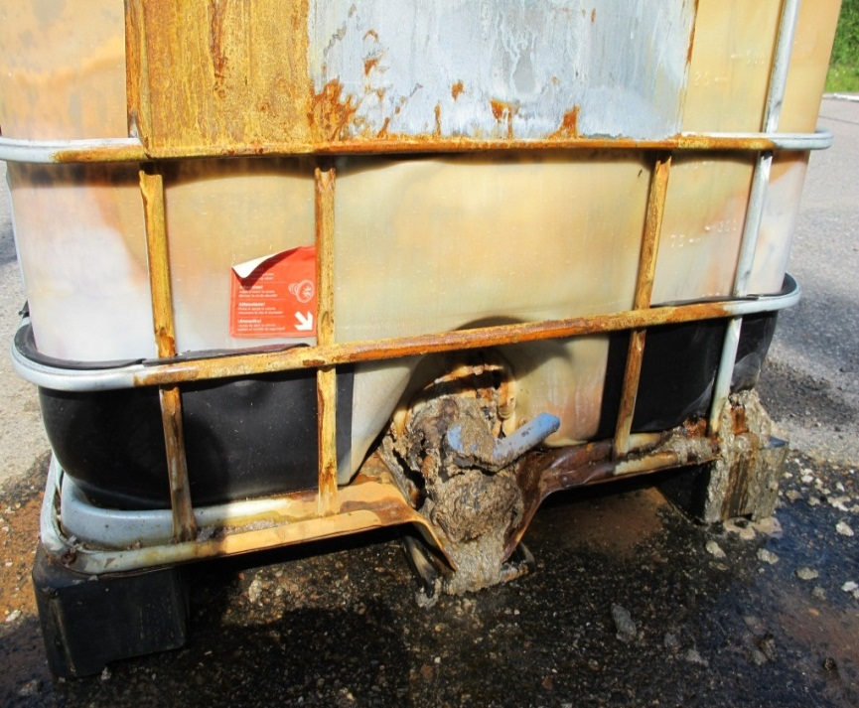
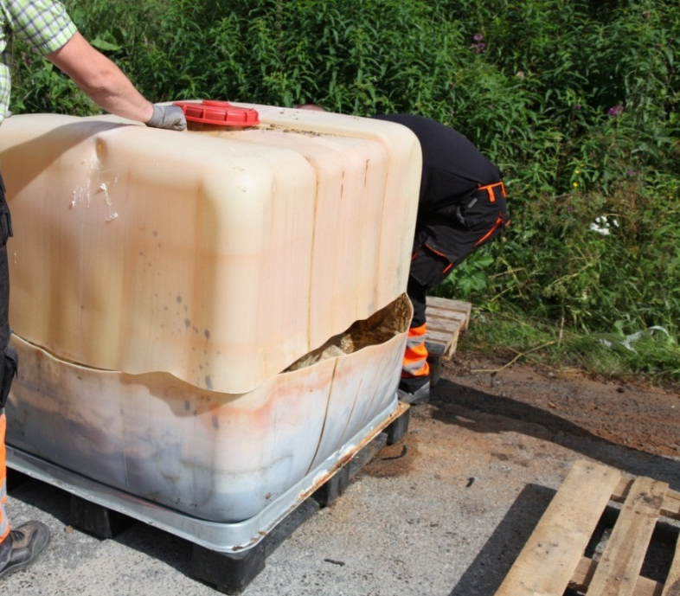
Why did the container start steaming? What did it contain?
Notes:
The first task in the investigation was to find out what was inside the steaming container and what caused the reaction.
The picture on the left shows the level of the contents. The emulsion waste container should only contain liquid material. However, as can be seen in the picture, about one third of the container held rock material.
The picture on the right shows that the container reached a high temperature. The steaming IBC container had melted in the right-hand corner and the area around the tap was damaged.
The following slides show the contents of the container more clearly.

Slide 10
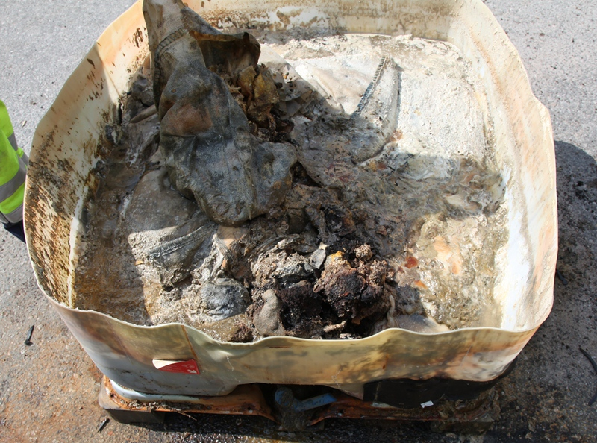
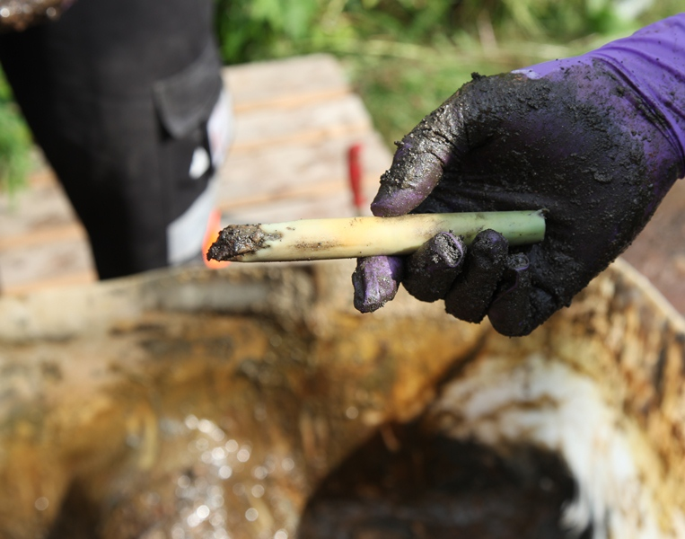
The steaming container held sensitized emulsion explosives, rock material, two detonators, and other impurities
Notes:
Tutkinnassa selvisi, että pakkauksessa oli herkistetyn emulsioräjähteen ja kiviaineksen seosta. Pakkauksessa tapahtunut reaktio johtuu emulsioräjähteessä olevan ammoniumnitraatin ja kiviaineksessa olevan pyriitin (rauta ja kuparisulfidien) välisest reaktiosta, joka voi lopulta johtaa ammoniumnitraatin nopeaan hajoamiseen tai mahdolliseen räjähdykseen.
According to the investigation findings, the container held a mixture of sensitized emulsion explosives and rock material. The ammonium nitrate in the emulsion explosives reacted with the pyrite in the rock material. Such a reaction is known to eventually lead to the fast decomposition or possible explosion of ammonium nitrate.
Tämä reaktiomahdollisuus on teoriassa tunnettu. Forcit ja Pyhäsalmen kaivos olivat selvittäneet reaktion mahdollisuutta Pyhäsalmen kiviaineksella, mutta näissä kokeissa ei ollut ilmennyt mitään. Kokeet oli tehty työturvallisuuden näkökulmasta.
The possibility of such a reaction is recognized in theory. Forcit and the Pyhäsalmi Mine had also investigated the possibility of the rock undergoing such a reaction in Pyhäsalmi. However, no reaction occurred in laboratory tests. These tests had been carried out from an occupational safety perspective.
Pakkauksesta löytyi myös kaksi räjäytintä. Räjäyttimen vaurioista näkee, että pakkauksen lämpötila on käynyt korkealla.
There were also two detonators in the container. Detonator damage showed that the temperature inside the container had been high.
Teoriassa pakkauksen mahdollinen räjähdys olisi voinut tapahtua joko herkistetyn emulsion ja kiviaineksen välisenä reaktiona tai räjäyttimien kuumenemisen kautta.
In theory, the container could have exploded in one of two ways: either as a result of a reaction between the sensitized emulsion and the rock material, or due to the heating of the detonator.
Pakkauksen jäähdyttäminen sisältäkäsin on ollut tärkeä toimenpide reaktion hillitsemiseksi.
The internal cooling of the container was essential in controlling the reaction.
Koska pakkauksessa oli herkistetyn emulsion ja kiviaineksen seosta sekä 2 alkuräjäytintä, tutkintaa päätettiin laajentaa myös Pyhäsalmen kaivokselle sen selvittämiseksi, miksi pakkaukseen oli päätynyt kiviaineksen ja herkistetyn emulsion välistä seosta ja muuta sinne kuulumatonta tavaraa.
As the mixture inside the container included sensitized emulsion and rock material as well as 2 detonators, a decision was made to extend the investigation to Pyhäsalmi Mine to find out how all the materials ended up in the same container.

Slide 11
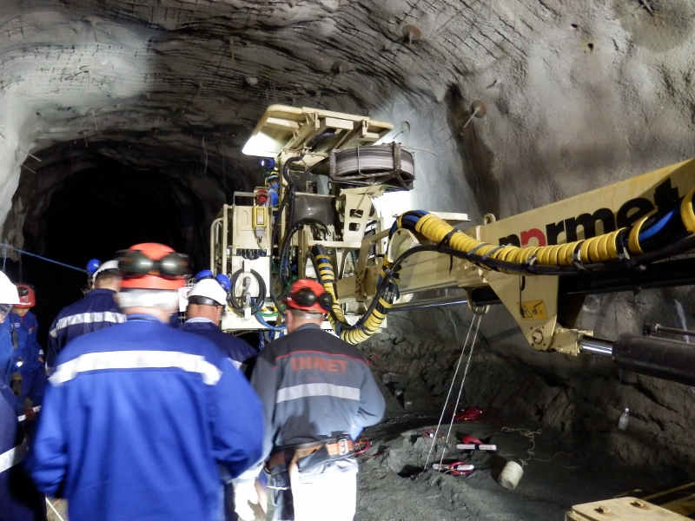
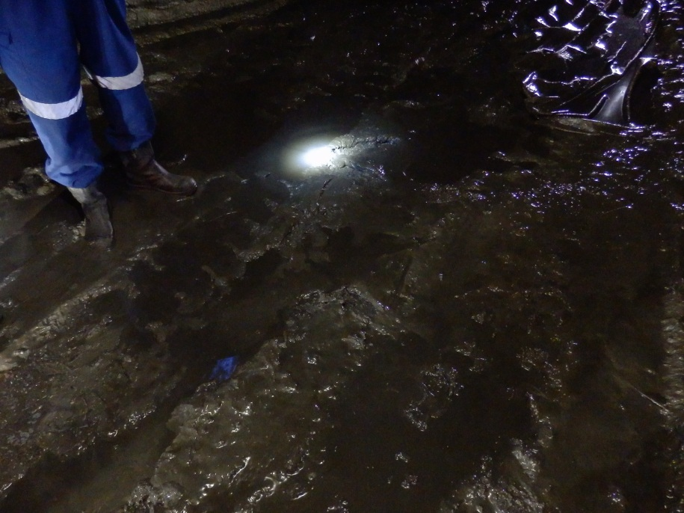
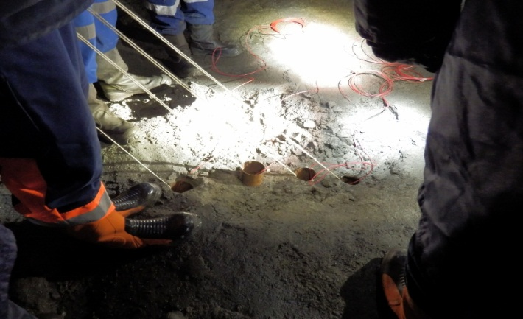
The waste container was originally from Pyhäsalmi Mine
Notes:
During the mine visit, it was discovered that exactly one year earlier, on 9 July 2012, an attempt to load the blast holes in the roof of the tunnel with emulsion explosives by means of a new mobile explosive manufacturing unit (Memu) had failed. As a result of this, a significant amount of sensitized emulsion dropped onto the tunnel floor.
As anyone who has visited a mine knows all too well, the conditions are characterized by darkness, humidity and muddiness. The wet tunnel can be seen in the picture bottom right.
The miners knew how important it is to clear sensitized emulsion away from the tunnel floor because it poses both a health and an environmental hazard. The mixture was collected and a waste container was ordered from Forcit.
According to instructions in the mine, large quantities of waste emulsion have to be dispatched to Forcit. The instructions concern both sensitized and unsensitized emulsion.
The error in the mine was that they did not realize that the mixture of sensitized emulsion and rock material should have been handled according to non-conformity instructions. Instead, they dispatched the waste container as typical 5.1 transportation class waste to the Vihtavuori site.
Only clean emulsion waste in liquid form is permitted to be transported. Hence, the container did not meet the legal transportation requirements.

Slide 12
Lessons learned from Pyhäsalmi Mine
One of the main factors in the incident was a new mobile explosive unit (MEMU) and the technical problems experienced in its commissioning phase. Technical problems led to an incident where a significant amount of sensitized emulsion dropped onto the tunnel floor.
A second important factor in the chain of events was that in Pyhäsalmi Mine the sensitized emulsion was mistakenly handled as a typical emulsion waste and was not recognized as a non-conformity.

Slide 13
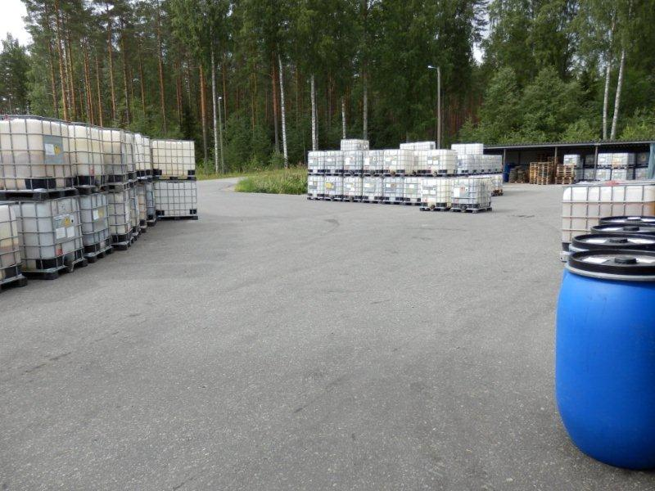
Storage of waste containers at the Forcit plant
Notes:
The third significant factor in the chain of events related to Forcit’s procedures and processes when receiving and storing waste containers at the Vihtavuori plant.
The receiving procedures at Forcit were based on oral instructions, but contrary to these instructions, containers with unidentified contents were accepted.
The waste containers had been stored next to the explosives factory and explosives warehouse, pending transportation to the waste plant.
Tukes had pointed out during several periodical inspections that the plant was not licensed to store waste containers, and requested Forcit to take corrective actions to solve the storage shortcomings.
For example, in autumn 2012, containers were moved away from the explosives factory yard, but new containers were subsequently stored there.
Forcit had taken several corrective actions, but these actions were inadequate due the simultaneous increase in production volumes.
At the time of the incident, the licence for a new warehouse area was under preparation at Tukes.

Slide 14
Part 3: Lessons learned from the Vihtavuori case

Slide 15
1. Proper procedures are needed to handle emulsion explosives waste
All parties need to ensure that they have adequate processes and procedures in place related to the handling, storage, transportation and disposal of emulsion explosives.
They also need to ensure that all measures are properly implemented and monitored.

Slide 16
2. Legal requirements need to be met
In major hazard installations everyone is responsible for safety and following instructions.
Managers need to ensure that legal requirements and instructions are met, and that corrective actions are adequate.

Slide 17
3. Change management and management of non-conformities need particular attention
Safety-critical changes may include a significant and rapid increase in production volumes, the use of new technology or new kinds of products, or changes relating to organisational structures and responsibilities, or supply chains.
There is a need to organise training for personnel and to improve instructions to better identify and manage the effect of these changes on safety.
In addition, there is a need to organise training for personnel and to improve instructions related to the identification and handling of deficiencies.

Slide 18
4. Emergency prepareness and training for emergency situations can be improved
The major accident scenarios presented in safety reports should be more systematically communicated when preparing internal and external emergency plans
In addition, training for those scenarios should be comprehensive

Slide 19
5. A reform of the Explosives Act is needed
A complete review and reform of the Explosives Act is essential
The requirements need to be updated to take into account the specific properties and risks connected with emulsion explosives
An up-to-date Act also provides a better basis for a surveillance authority like Tukes to work from

Slide 20
Further information: Major accident risk in Vihtavuori: investigation report abstract (Available at www.tukes.fi PDF) Investigation group: Kirsi Leva, Jesse Nurmela and Mikko Ojala

